Slide 1
SERVER SIDE RENDERING (nextjs)
PRESENTER: HO THI KHUA

Slide 2
AGENDA
Server Side Rendering (SSR) concept
SSR with getServerSideProps
SSR with Dynamic Parameters
getServerSideProps context
Demo

Slide 3
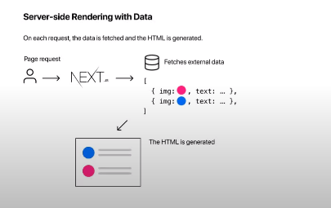
1. Server Side Rendering concept
SSR is a form of pre-rendering where the HTML is generated at request time.
SSR is required when you need to fetch data per request and also when you need to fetch personalized data keeping in mind SEO.

Slide 4
2. SSR with getServerSideProps
1.
getServerSideProps runs only on the server - side
The function will never run client - side
The code you write inside getServerSideProps won’t even be included in the JS bundle that is sent to the browser
2.
You can write server-side code directly in getServerSideProps
Accessing the file system using the fs modules or querying a database can be done inside getServerSideProps
You also don’t have to worry about including API keys in getServerSideProps as that won’t make it to the browser
3.
getServerSideProps is allowed only in a page and cannot be run from regular component file
It is used only for Pre-rendering and not client – side data fetching

Slide 5
2. SSR with getServerSideProps
4.
getServerSideProps should return an object and object should contain a props key which is an object
5.
- getServerSideProps will run at request time

Slide 6
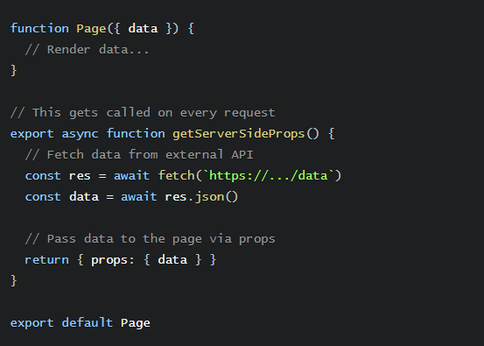

Slide 7
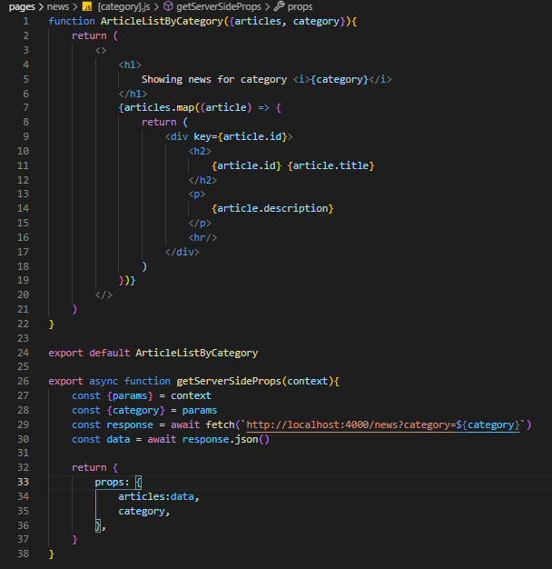
3. SSR with Dynamic Parameters

Slide 8
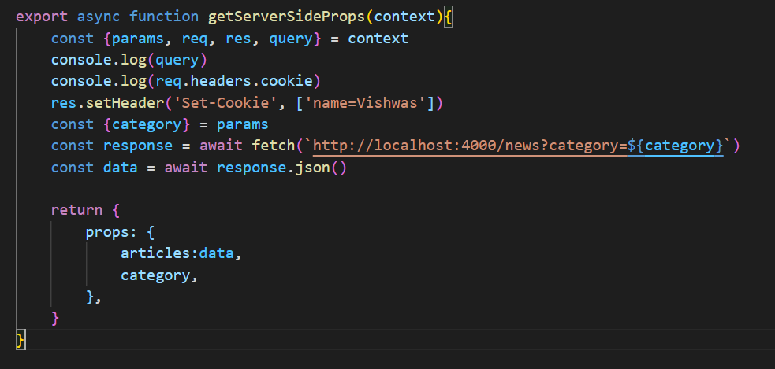
4. getServerSideProps context

Slide 9
DEMO

Slide 10


